Slide 1
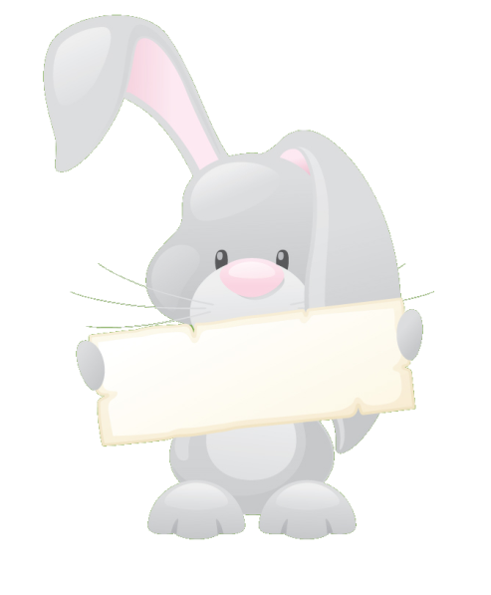
Tricky Words: Phases 2 to 5

Slide 2
Notes for teachers
This presentation uses triggers, motion paths and action buttons. The triggers allow the presentation to be worked through at a pace that suits your needs. Using the choice screen, select your phase. Each slide shows a magician’s hat. Every time to click on the hat a rabbit, holding a tricky word, will jump out. Pupils can then read the word that they see. Clicking the wand will make it disappear and children can try the next word. Click on the example below to see how this works.
.
the

Slide 3
Choose your Phase
Phase 2
Phase 3
Phase 4
Phase 5
Quit

Slide 4
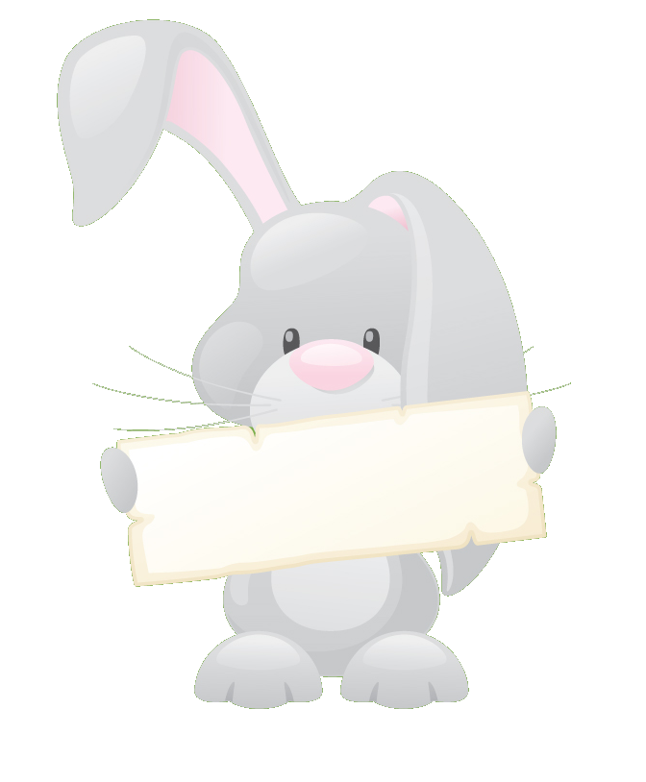
Phase 2
6 words
the
to
I
no
go
into

Slide 5
Phase 3
12 words
my
her
we
be
you
they
all
are
me
was
he
she

Slide 6
Phase 4
14 words
little
when
out
so
one
said
do
come
were
have
some
like
what
there

Slide 7
Phase 5
9 words
Mr
oh
their
Mrs
could
asked
called
looked
people

